Slide 1
cats
by: jonathan chow

Slide 2
index.html
famous_cats.html
cats_getting_scared_by_cucumbers.html
about/contact
.html
404.html

Slide 3
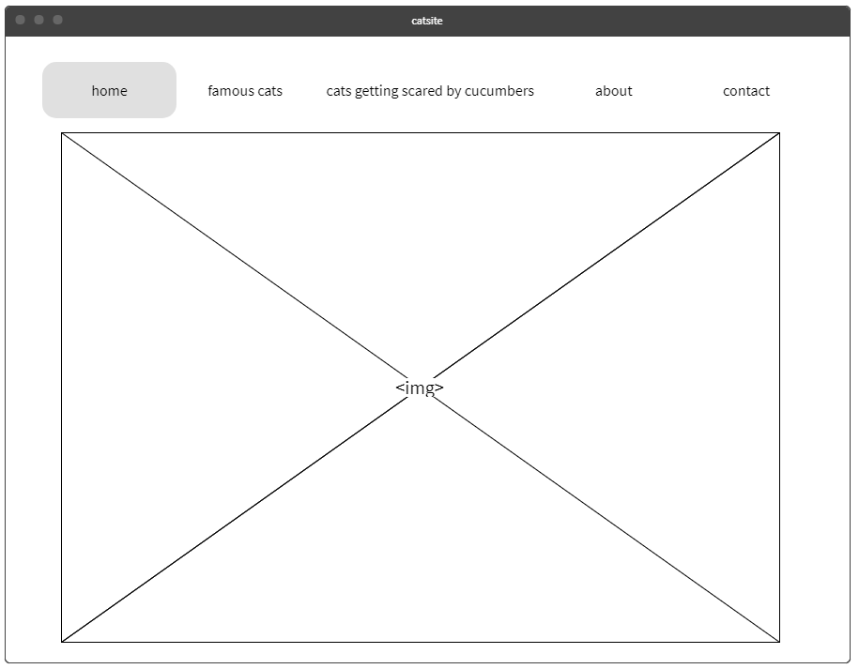

Slide 4
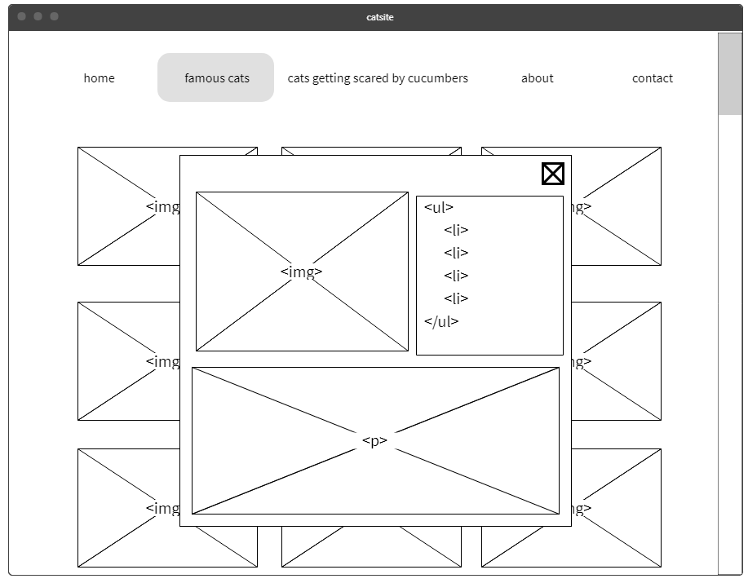
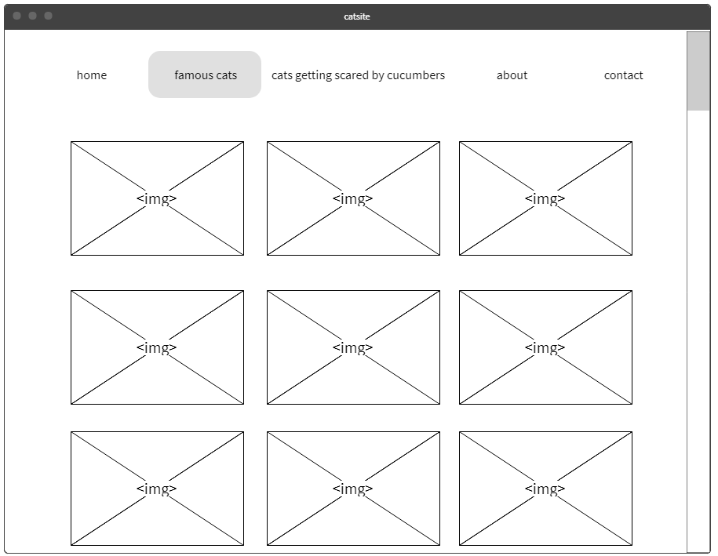

Slide 6
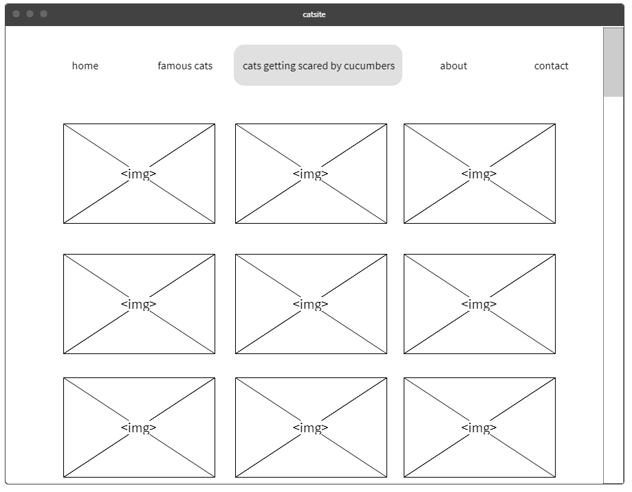

Slide 7
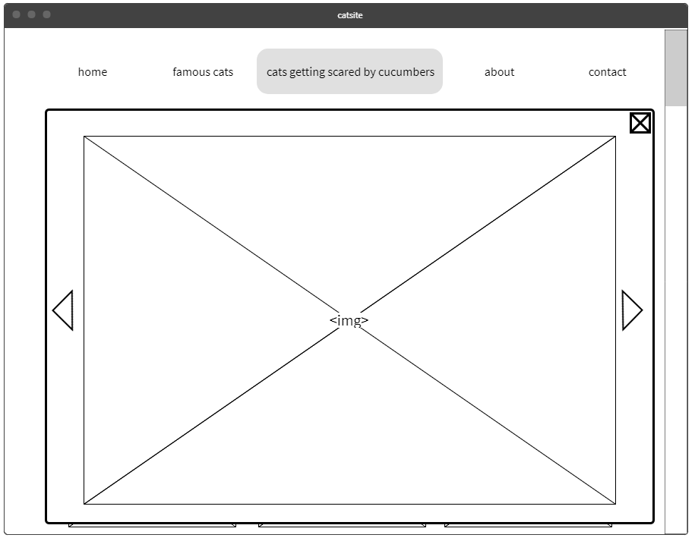

Slide 8
